Slide 1
Russian Economic Report No. 26
Growing Risks
Zeljko Bogetic
Lead Economist and Coordinator for Economic Policy for Russia, The World Bank
Sergei Ulatov
Resident macroeconomist, Moscow office
September 15, 2011
Moscow

Slide 2
OUTLINE
Growing risks to global outlook
Recent economic developments and policies
Russia’s outlook for 2011-2012

Slide 3
I. Global trends
Growing risks to global growth and commodity prices:
Dramatic mark-down of U.S. sovereign debt ratings
Lower-than-expected growth in the U.S. and EU in the first half of 2011
Global market turbulence
Renewed uncertainties about the European debt crisis
Preliminary, downward revisions to the global outlook
High-income countries’ growth to slow to 1.6 percent in 2011 from 2.7 percent in 2010
Slowing of growth in low- and middle-income countries is less pronounced: to 6 percent in 2011 from more than 7 percent in 2010

Slide 4
Global Industrial Production: Output Momentum Slowing
Source: Global prospects, World Bank.

Slide 5
Capital flows to developing countries-reflecting rising risks and uncertainty
Source: Global prospects, World Bank.

Slide 6
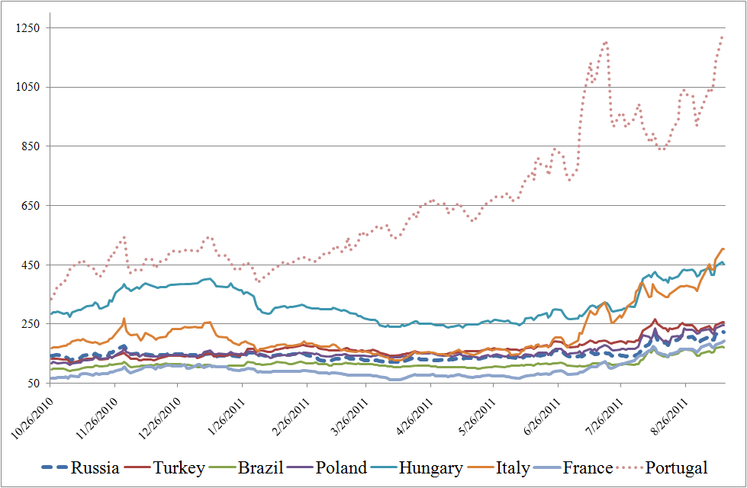
Continuing debt crisis in the Eurozone and rising global uncertainty
Selected Credit Default Swap Spreads
five-year sovereign credit default swaps, basis points
Source: Bloomberg.

Slide 7
RUSSIA’S RECENT ECONOMIC DEVELOPMENTS AND MACRO POLICIES IN 2011
Economic growth slowed in the second quarter of 2011 as the inventory restocking cycle waned
Balance of payments – deteriorating because of capital outflows
External debt - improving access to longer-term financing
Labor markets –– improving unemployment, rigid poverty
Monetary policy–– slowing money growth and inflation
Fiscal policy––postponing adjustment

Slide 8
Lower than expected but broad based growth in the first half of 2011: growth in domestic demand has not been as strong as anticipated
GDP growth by main sectors (value added): 2007–2011
 | 2007 | 2008 | 2009 | 2010 | Q1-2011 | Q2-2011
GDP growth | 8.5 | 5.2 | −7.8 | 4.0 | 4.1 | 3.4
Tradable sector | 3.6 | −0.2 | −8.0 | 6.3 | 8.3 | 4.7
Agriculture, forestry | 1.3 | 6.4 | 1.3 | −10.7 | 1.1 | 0.5
Extraction industries | −2.2 | 1.0 | 0.5 | 4.7 | 2.4 | 2.2
Manufacturing | 7.5 | −2.1 | −14.9 | 12.3 | 12.9 | 6.9
Nontradable sector | 12.4 | 9.2 | −7.2 | 2.9 | 2.4 | 2.4
Electricity, gas, and water production and distribution | −3.4 | 0.7 | −5.0 | 5.5 | -0.3 | 2.0
Construction | 13.0 | 11.1 | −14.6 | -0.7 | 0.8 | 0.1
Wholesale and retail trade | 11.7 | 9.9 | −6.2 | 5.0 | 1.3 | 2.3
Transport and communication | 4.8 | 5.2 | −8.5 | 7.7 | 5.1 | 3.7
Financial services | 29.1 | 13.5 | 2.2 | −2.4 | 2.0 | 2.5
Source: World Bank staff calculations based on Rosstat data.

Slide 9
Balance of payments - overall position deteriorated in H1 2011 because of large net capital outflows
US$ billions
 | 2007 | 2008 | 2009 | 2010ª | H1 2010 | H1 2011ª
Current account balance | 77.0 | 103.7 | 48.6 | 71.1 | 52.1 | 57.6
Trade balance | 130.9 | 155.4 | 111.6 | 151.4 | 86.1 | 101.7
Capital and financial account | 84.8 | −131.3 | −43.5 | −26.4 | −3.1 | −28.7
Errors and omissions | −12.9 | −11.3 | −1.7 | −8.0 | −6.3 | −6.0
Change in reserves (+ = increase) | 148.9 | −38.9 | 3.4 | 36.8 | 42.7 | 23.0
Memo: average oil price (Brent, US$/barrel) | 72.5 | 96.9 | 61.5 | 79.5 | 77.3 | 111.0
Source: CBR. ª Preliminary estimates.

Slide 10
Net capital outflows remained large in H1 2011 (albeit slowing in Q2) despite high oil prices and continued moderate growth
 | 2006 | 2007 | 2008 | 2009 | 2010 | H1 2010 | H1 2011 | Q1 2001
Total net capital inflows to the private sector | 41.4 | 81.7 | −133.9 | −56.9 | −35.3 | −11.5 | −31.2 | −21.3
Net capital inflows to the banking sector | 27.5 | 45.8 | −56.9 | −31.4 | 15.9 | 7.6 | −11.9 | −7.7
Net capital inflows to the nonbanking sector | 13.9 | 35.9 | −77 | −25.4 | −51.2 | −19.2 | −19.3 | −13.7
Source: CBR, Global prospects.

Slide 11
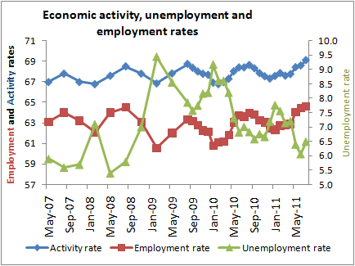
The labor market outcomes: gradually improving during the first half of 2011; Unemployment in July 6.5%
Sources: Rosstat; World Bank staff estimates.

Slide 12
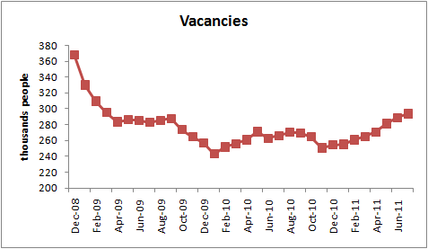
And vacancies have been growing steadily since December 2010, especially in manufacturing and finance

Slide 13
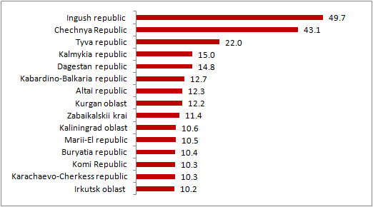
Yet many Russia’s regions are experiencing very high unemployment rates with attendant social risks

Slide 14
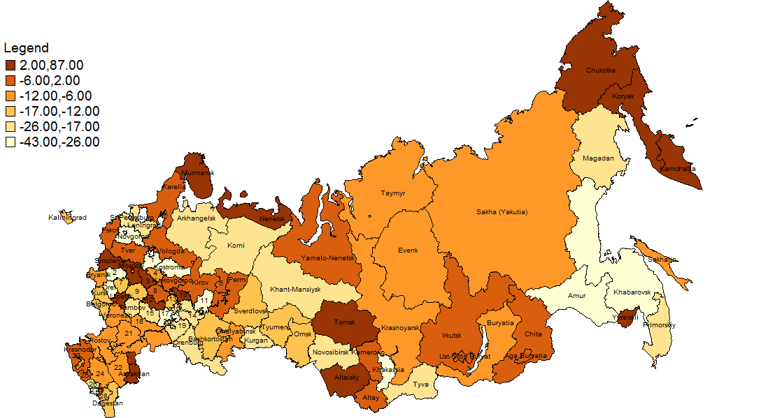
Percentage increase in unemployment in Q1 2011 from a year ago—the lighter the color the lower the unemployment

Slide 15
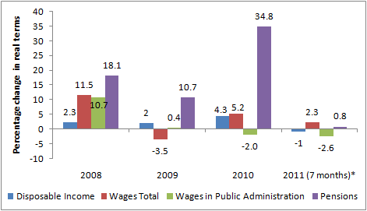
Real wages and pensions increased slightly, along with the rise in productivity
*6 months for public administration wages.
Source: Rosstat, WB staff calculations.

Slide 16
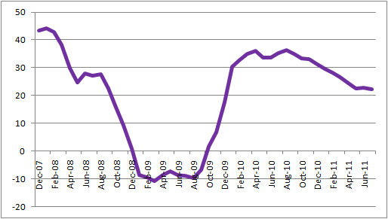
Monetary and exchange rate policy
Inflation concerns faded in July–August because of seasonal factors. Strong grain harvest.
12-month CPI has fallen to 8.2 percent in August 2011 from 9.5 percent in June 2011.
Monetization of the economy has slowed. Nominal M2 growth slowed to a still high average of 25.2 percent in January–July 2011 y-o-y from 33.6 percent in the same period of 2010.
The CBR kept the REPO rate unchanged, cut its repurchase rate and raised deposit rate; then cut repo rate and raised deposit rate in September signaling more active posture in view of global risks
Money Supply Growth, % (M2, y-o-y)
Source: CBR; World Bank staff estimates.
Notes:
The overnight auction-based repo rate was lowered a
quarter-point to 5.25 percent, the first cut since last May, and
the overnight deposit rate was increased by the same amount to
3.75 percent

Slide 17
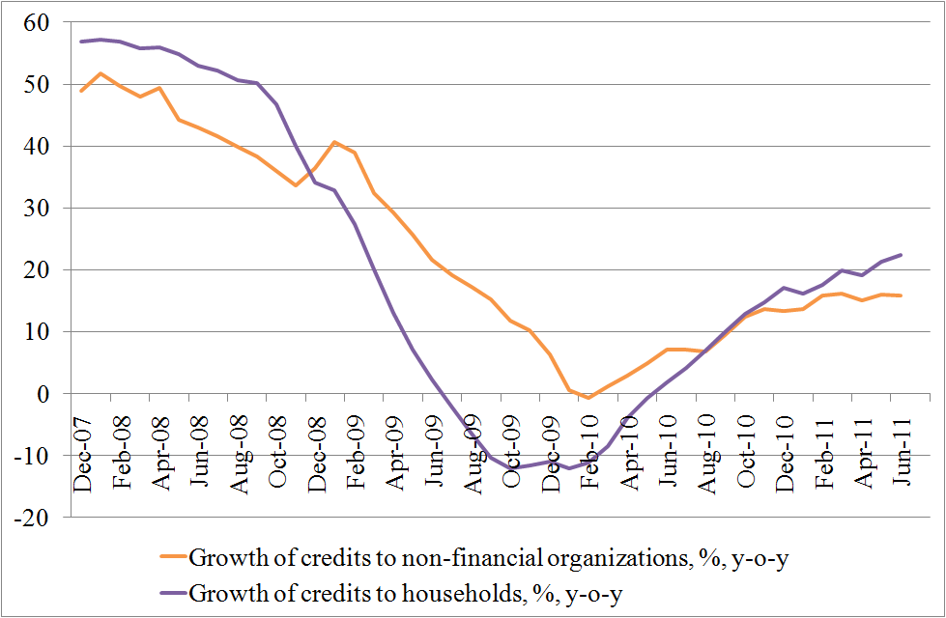
With continued decline in lending rates, robust credit recovery continues, but the share of total credits to the private sector in GDP remains low
Sources: CBR; World Bank staff estimates.

Slide 18
Amendment to 2011 Federal Budget
% of GDP
 | 2011 Federal budget) | 2011 amendment | Change
Revenues | 17.6 | 19.3 | 1.7
Oil revenues | 8.1 | 9.8 | 1.7
Non-oil revenues | 9.5 | 9.5 | 0.0
Expenditures | 21.2 | 20.7 | −0.5
Deficit | 3.6 | 1.3 | −2.3
Non-oil deficit | 11.7 | 11.1 | −0.6

Slide 19
Notwithstanding the short-term federal budget surplus and the low public debt, the new budget plan for 2012–14 raises concerns about the long-term fiscal sustainability of Russia’s public finances
 | 2012 | 2013 | 2014
Consolidated budget 1/
Revenues | 37.1 | 36.6 | 36.1
Expenditures | 39.1 | 38.4 | 37.0
Surplus/Deficit | –1.9 | –1.8 | –0.9
Federal budget 2/
Revenues | 20.1 | 19.6 | 19.5
Expenditures | 21.6 | 21.2 | 20.2
Surplus/Deficit | –1.5 | –1.6 | –0.7
Surplus/Non-oil deficit | –11.0 | –10.3 | –9.2
Source: Ministry of Finance, Economic Expert Group.
1/ Estimates of the World Bank staff based on published budget parameters.
2/ Ministry of Finance preliminary budget parameters published on September 12, 2011.

Slide 20
II. Global Outlook, 2011-2012 real GDP growth, %
 | 2009 | 2010 | 2011 (projected) | 2012 (projected)
World | −2.2 | 3.8 | 2.8 | 3.2
High-income countries | −3.4 | 2.7 | 1.6 | 2.2
Developing countries | 1.9 | 7.4 | 6.0 | 6.0
Russian Federation | −7.8 | 4.0 | 4.0 | 3.8
Source: World Bank Staff Estimates; preliminary.

Slide 21
The oil price outlook has been revised downward
World Bank oil price forecast. Average crude
(Brent, Dubai and WTI), simple average, $/bbl
Source: World Bank staff.

Slide 22
Outlook for Russia: 2010 - 2012
 | 2011 | 2012
GDP growth (%) | 4.0 | 3.8
Consolidated government balance (%) | -0.2 | -1.6
Current account (US$ billions) | 67.0 | 21.0
Percentage of GDP | 3.8 | 1.1
Capital account (US$ billions) | -30.0 | -6.0
Percentage of GDP | -1.7 | -0.3
Oil price assumption (US$ per barrel) | 103.0 | 94.7
Source: Russian Economic Report, The World Bank.

Slide 23
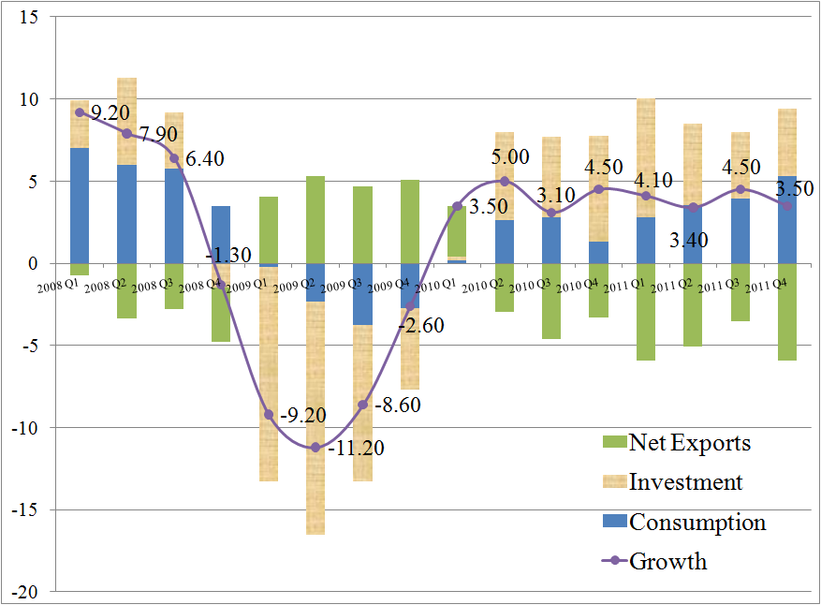
Demand Sources of Russia’s Growth
Demand sources of Russia’s real growth, by quarter, 2008–11 (percent change year to year)
Source: Rosstat; World Bank staff estimates.

Slide 24
Russia’s national poverty rate during 2009 and 2010 was essentially flat, and the government managed to cushion the effect on the poor through a large fiscal stimulus, but poverty reduction going forward will be more difficult
Sources: Rosstat, actual data for 2006–10; RER team calculations based on Household Budget Survey data and projections for 2011–12.

Slide 25
Thinking About the Unthinkable: How Bad Can it Get in Russia?
TWO RISK SCENARIOS
“moderate shock” scenario:
global growth outlook gradually deteriorates, but remains positive, reflected in lower oil price outlook to an average of US$80 (a drop of about US$15 compared with the baseline outlook).
“severe shock” scenario:
global outlook is severely affected by the recession in one of the major economic blocks, resulting in a sharp contraction in global demand and demand for oil. Under these conditions, oil demand would fall sharply and prices could again average $60 in 2012 (as in 2009).
Notes:
The sharply rising uncertainties in the global economy call for thinking through alternative scenarios and their implications for the Russian economy. We explored two, mainly illustrative scenario, to underscore the vulnerability of the Russian economy to a new drop in global and oil demand and emphasize the need for smart medium-term fiscal adjustment that includes significant improvements in the effectiveness of public spending and better targeting of the social programs.

Slide 26
“Moderate shock” scenario: in 2011, growth is moderately affected, but in 2012 growth is cut by 2 percentage points from the baseline. “Severe shock” scenario: Russia’s economy would enter a recession with negative growth in 2012.
Simulations: Russia’s real GDP growth
Source: Rosstat; World Bank staff estimates.

Slide 27
Simulations: Unemployment
“Moderate shock” scenario: unemployment would trend back to 7 percent in 2012.
“Severe shock” scenario: unemployment is rising almost 1.5 percentage points higher than in the baseline outlook in 2012.
Source: Rosstat; World Bank staff estimates

Slide 28
Simulations: Consolidated Budget Balance
“Moderate shock scenario”: in 2012, without corrective adjustment, fiscal balance deteriorates sharply to 3.1 percent of GDP. This would likely result in the use of remaining balances in the Reserve Fund and recourse to domestic financing.
“Severe shock” scenario: without countervailing fiscal measures, fiscal balance would turn into a deficit of about 5.3 percent of GDP. This would require a combination of fiscal measures, including financing.
Source: Rosstat; World Bank staff estimates

Slide 29
Simulations: Consumption
The pattern of real consumption in Russia is expected to remain resilient to negative shocks with consumption growth remaining higher than GDP growth in 2011–12.
Source: Rosstat; World Bank staff estimates

Slide 30
In sum: Russia’s outlook
Global growth is now projected to slow in the face of significant market turbulence, slowdown in the United States and European Union, and associated uncertainties.
With heightened risks to global growth and lower commodity prices, we now expect Russia’s real GDP to grow 4 percent in 2011 (down from 4.4 percent expected in June) due to the lower Q2 outcome and the impact on domestic demand of the external conditions.
The balance of payments position is expected to deteriorate toward end-2011, while capital flows are likely to remain volatile, reflecting increased global uncertainties.
Unemployment is expected to remain under 7 percent but as the activity returns to pre-crisis level, further reduction in unemployment and poverty will be slow.
Given the current trends and policies, we expect inflationary pressures to diminish somewhat faster than we projected before.

Slide 31
Downside scenarios suggest
Relatively soft landing of growth to 3.5 percent in 2011 and 2 percent in 2012 and financeable fiscal deficit of about 3 percent of GDP
Hard landing to 3.3 percent growth in 2011 and -1.5 percent in 2012 with fiscal deficit exceeding 5 percent of GDP requiring comprehensive fiscal measures

Slide 32
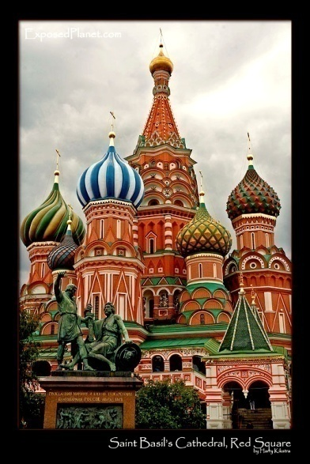
Thank you!

